Slide 1

Funny Gorilla诙猩猩-IT培训
Your success is our success
Data Types

Slide 2
Learning Objectives
By the end of this learning module, you will be able to understand:
What is API
Why API
Where is API located
API types
Transport Protocol - HTTP
Data Contract
Rest API
OpenAPI Specification
API lifecycle

Slide 3
Data Contract

Slide 4
XML
JSON
AVRO

Slide 5
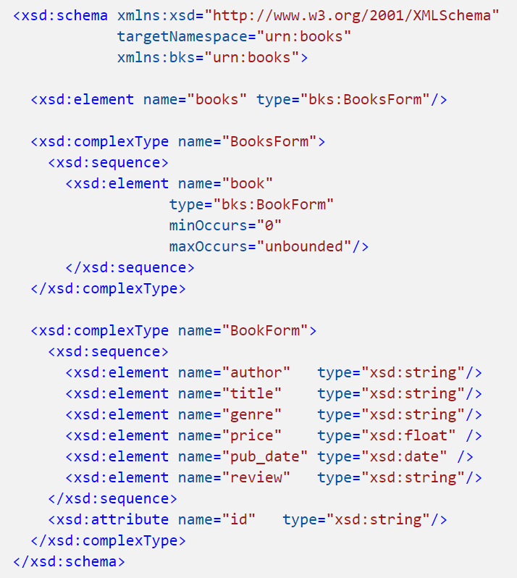
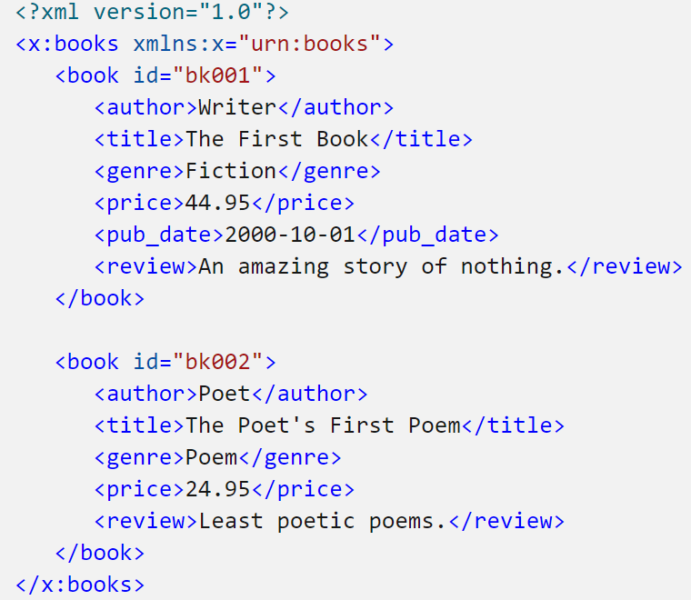
XML
XSD

Slide 6
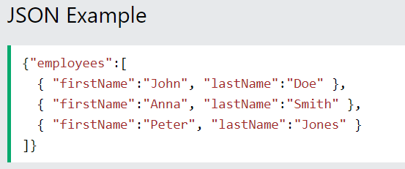
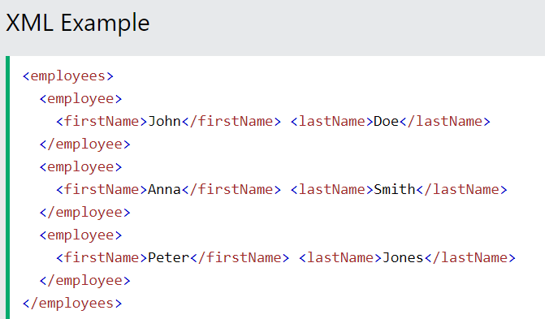
JASON

Slide 7
AVRO

Slide 8
References
Http | https://www.tutorialspoint.com/http/http_overview.htm
XML | https://www.w3schools.com/xml/default.asp
SOAP | https://www.tutorialspoint.com/soapui/soap_introduction.htm
SOAPUI | https://support.smartbear.com/readyapi/docs/get-started.html
JSON | https://www.w3schools.com/js/js_json_intro.asp
REST | https://aws.amazon.com/what-is/restful-api/
Postman | https://learning.postman.com/docs/getting-started/introduction/
https://blog.devgenius.io/how-to-speed-up-your-api-tests-using-the-advanced-features-of-postman-350c453b376

Slide 9

Your success is our success
Contact
Mail: info@funnygorilla.com.au
Linkedin: https://mt.linkedin.com/in/songqing-gu-2ba9034b/de
Web Chat: FunnyGorilla
Phone: 0420891343

